Slide 1
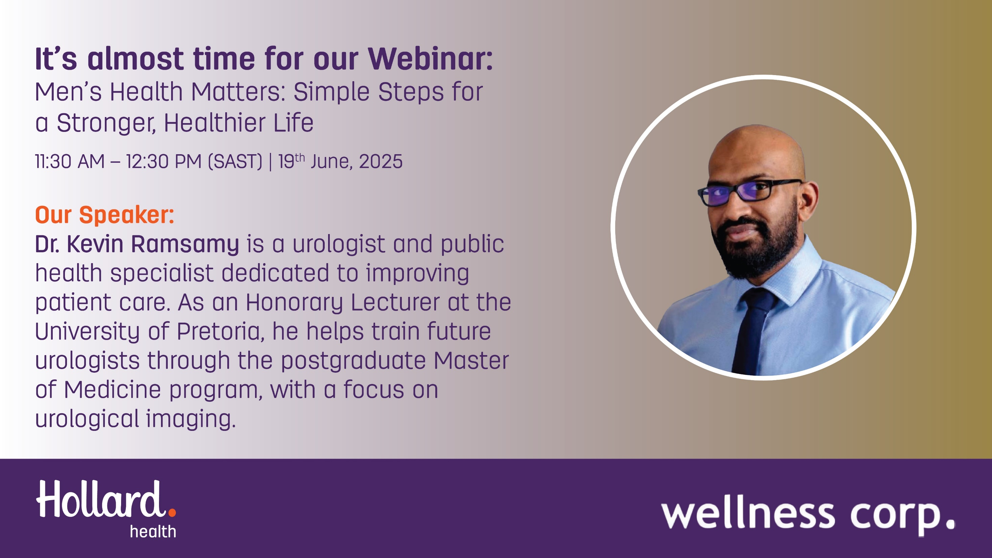

Slide 2



wellness corp.
Dr. Kevin Ramsamy – Urologist
MEN'S HEALTH MATTERS:
Simple steps to a stronger,
healthier life
Contact
Website
+258 84788 0055
www.wellness-corporate.com

Slide 3

wellness corp.
Page 1
Break the Silence
Let’s change perceptions and create an environment where men’s health is a priority without shame or hesitation.
Discover practical strategies and perspectives to tackle this crucial issue.
Dr. Kevin Ramsamy – Urologist
www.wellness-corporate.com

Slide 4
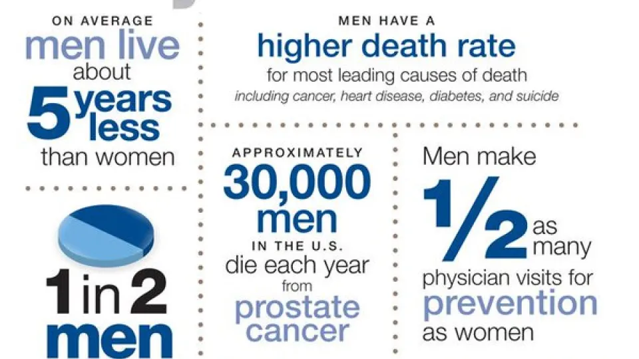
wellness corp.
Facts About Male Health
On average, Men:
Live seven years less than women (due to biological and behavioral factors).
Die more often from heart disease at younger ages.
Hold the most dangerous jobs.
Have higher suicide rates than women.
Chronic illnesses are more prevalent.
Seek medical care less frequently.
Dr. Kevin Ramsamy – Urologist
www.wellness-corporate.com

Slide 5
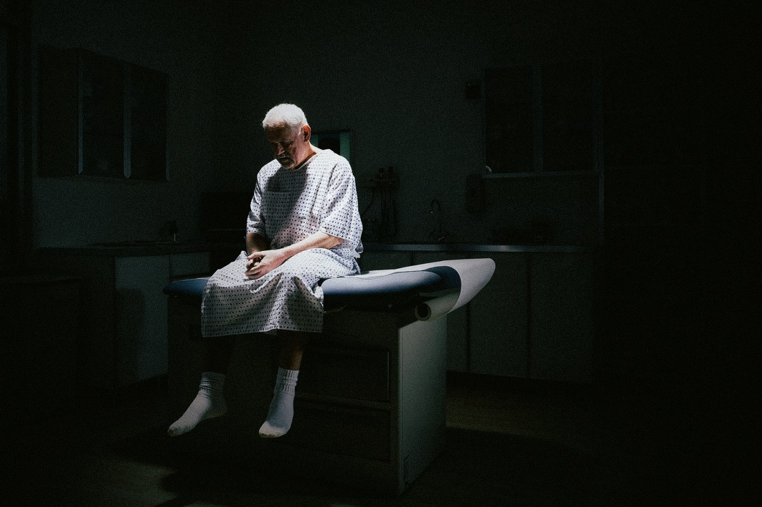
wellness corp.
Page 1
Why Do Men Avoid Doctors?
Perception of strength
Fear of diagnosis
Lack of time
Privacy concerns and embarrassment
Cultural barriers
Dr. Kevin Ramsamy – Urologist
www.wellness-corporate.com

Slide 6

wellness corp.
Page 1
Consequences of Medical Avoidance
Late detection of diseases
Worsening of treatable conditions
Impact on family
Decreased quality of life
Dr. Kevin Ramsamy – Urologist
www.wellness-corporate.com

Slide 7
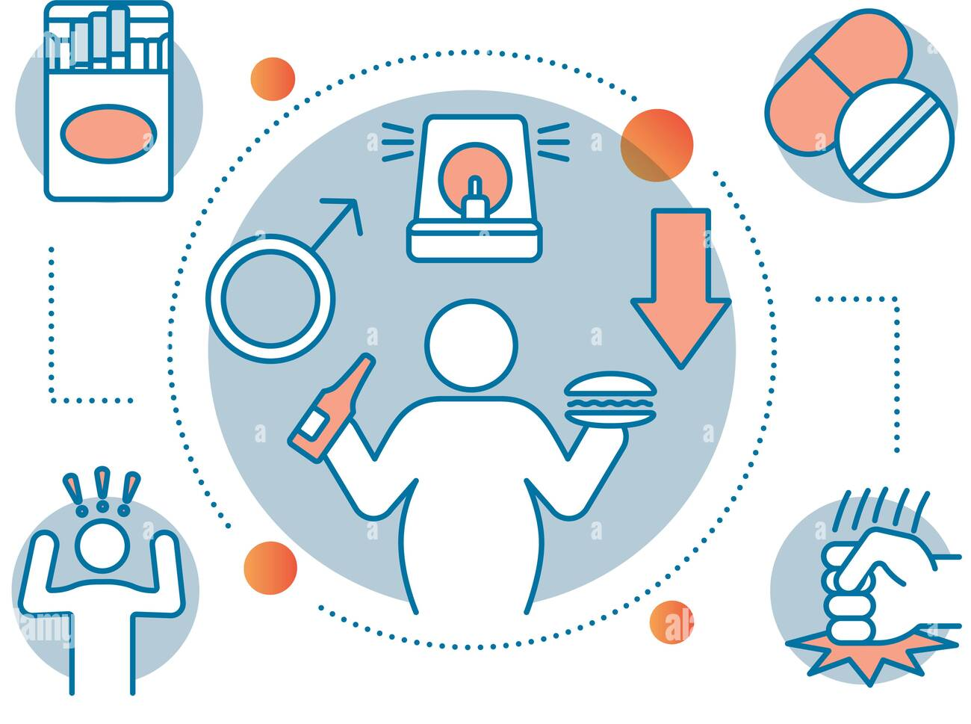
wellness corp.
Risk Factors That Influence Men’s Health
Depression
Age
Genetic factors
Obesity
Chronic diseases
Smoking
Excessive alcohol consumption
Drug use
Sedentary lifestyle
Anxiety
Dr. Kevin Ramsamy – Urologist
www.wellness-corporate.com

Slide 8
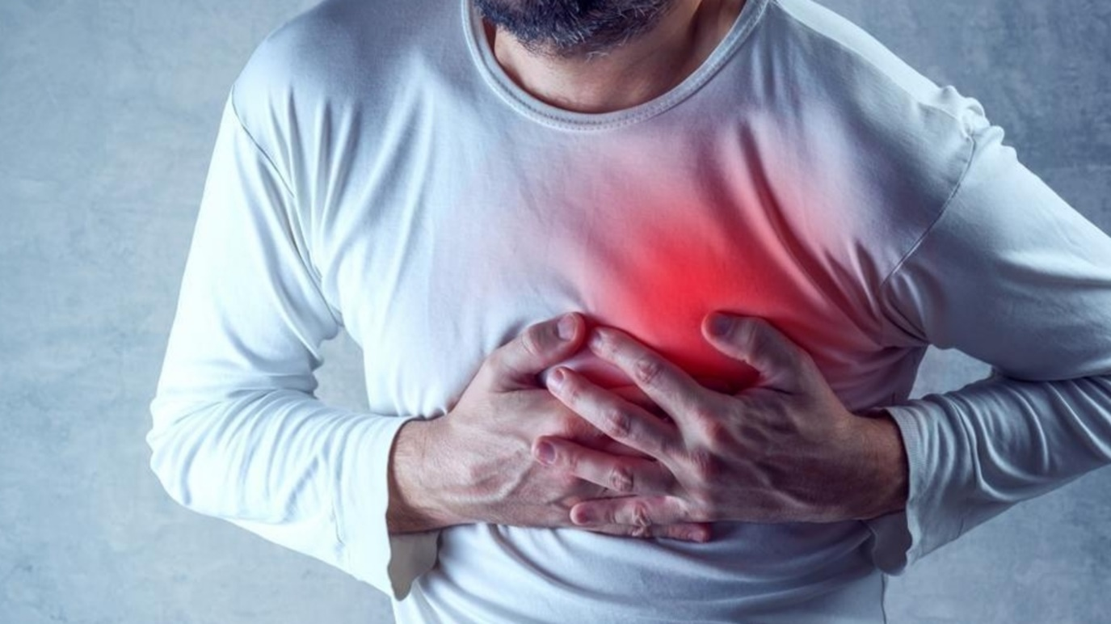
wellness corp.
Page 1
Main Health Issues That Affect Men
Cardiovascular disease at the heart
of the issue
Risk Factors: Hypertension, Dyslipidemia, Chronic stress, Sedentary lifestyle, Smoking
Prevention: Regular physical activity, Balanced diet, Annual medical check-ups
Impact on men: leading causes of mortality
Dr. Kevin Ramsamy – Urologist
www.wellness-corporate.com

Slide 9




wellness corp.
Male-Specific Cancers: Be Vigilant
Prostate Cancer
Testicular Cancer
Common after age 50. Early screening improves outcomes.
Affects younger men. Regular self-exams recommended.
Colorectal Cancer
Risk increases with age. Colonoscopy is effective for screening.
These cancers require special attention and regular check-ups. Early detection is key to successful treatment.
Dr. Kevin Ramsamy – Urologist
www.wellness-corporate.com

Slide 10
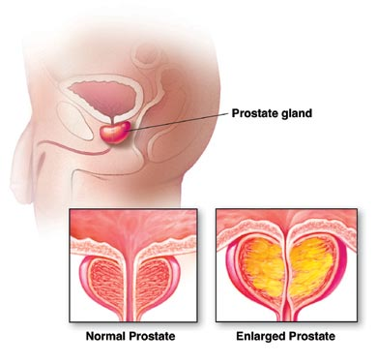
wellness corp.
Prostate Diseases
Prostate Cancer
Second most common cancer in men. Second leading cause of cancer-related death. It is curable when diagnosed early.
Benign Hyperplasia
From age 50: The prevalence accelerates significantly. Elderly (60 years or older): BPH becomes almost universal at advanced ages.
Prostatitis
Causes persistent pain and discomfort in the male pelvic region. Affects 8% to 16% of men globally. More common in young men.
Dr. Kevin Ramsamy – Urologist
www.wellness-corporate.com

Slide 11

wellness corp.
Sexual Health
Erectile Dysfunction
50% of men over the age of 40 experience ED at some point in their lives.
Premature Ejaculation
1 in 4 men experience it at some point in life.
Male Infertility
It is present in half of the cases when there is difficulty in achieving pregnancy.
Dr. Kevin Ramsamy – Urologist
www.wellness-corporate.com

Slide 12
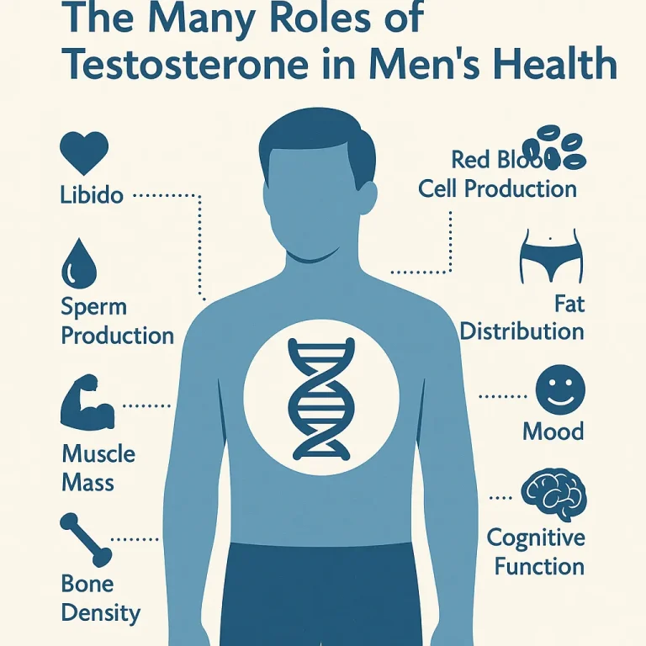
wellness corp.
Testosterone and Hormonal Health in Man
Low Testosterone Definition:
AUA < 300ng/dL
Or EAU < 12 nmol/L
Low Testosterone causes:
Testicular production (primary Hypogonadism)
Testicle stimulation (secondary Hypogonadism)
Receptor dysfunction
Late Onset Hypogonadism: persistent symptoms
with low testosterone. (idiopathic).
Low Testosterone Symptoms:
Sexual : Ejaculation and arousal, Low libido, Morning erections
Physical : Decreased physical strength and energy,
Psychological, Low mood and motivation, Fatigue, Low concentration.
Dr. Kevin Ramsamy – Urologist
www.wellness-corporate.com

Slide 13
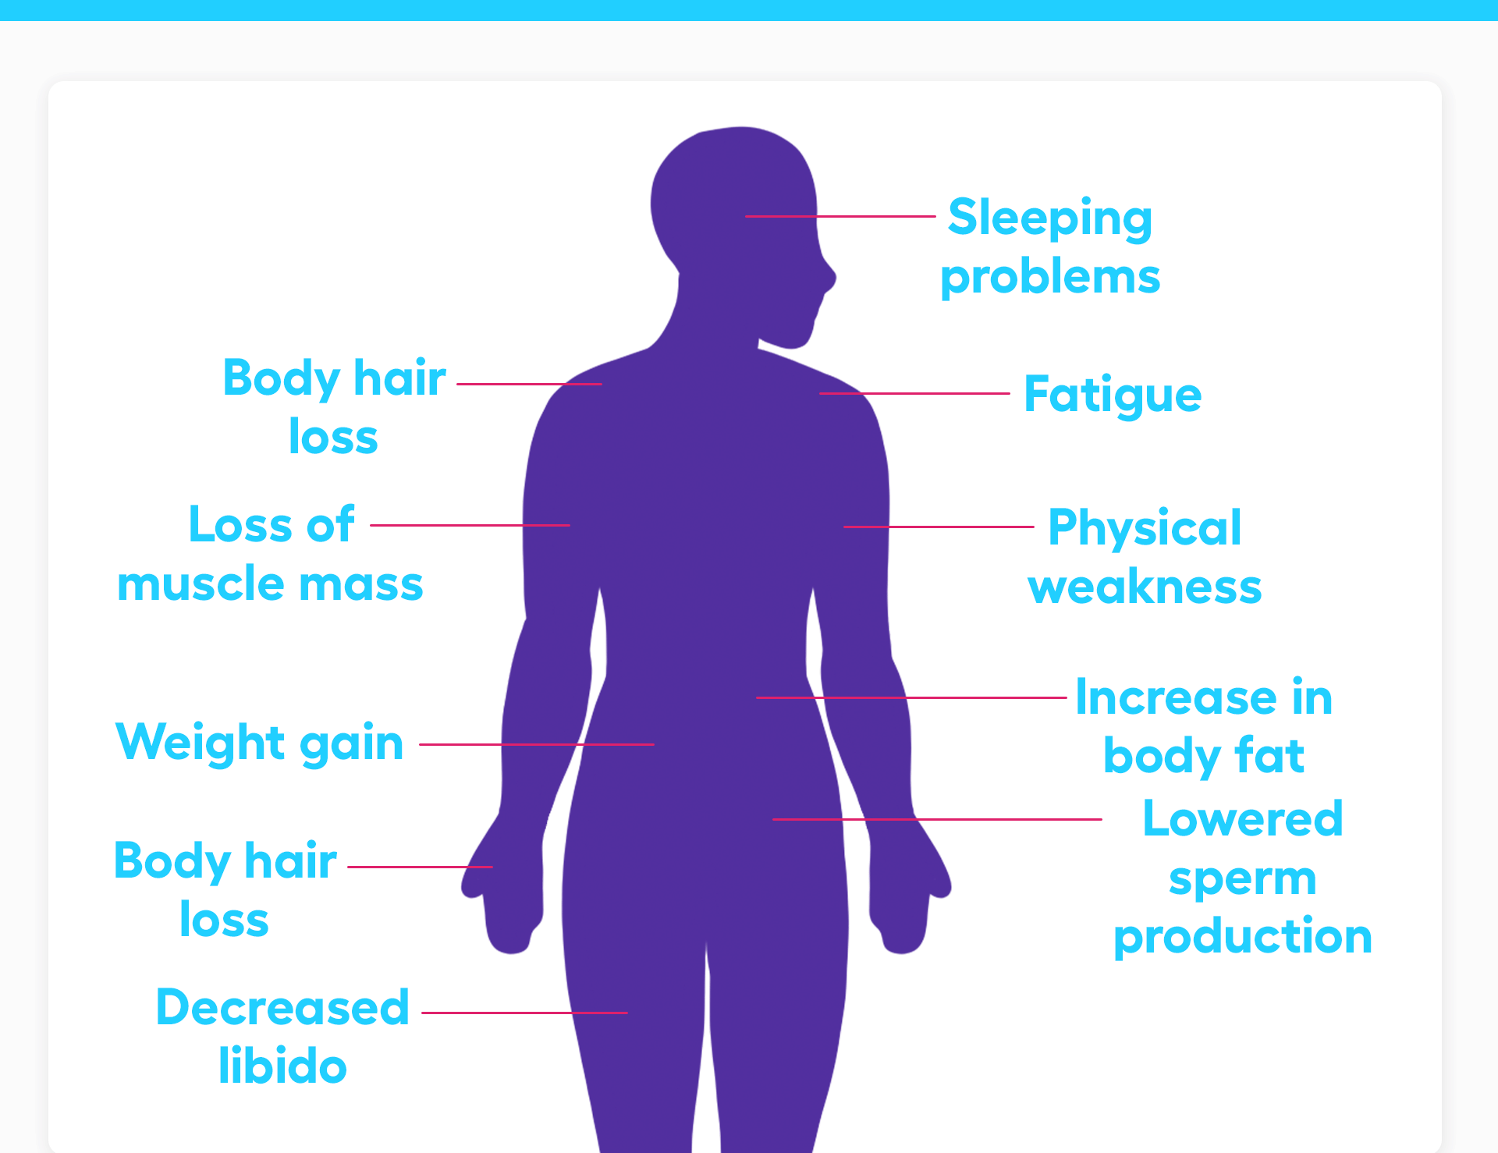
wellness corp.
Testosterone and Hormonal Health in Men
LOW TESTOSTERONE SYMPTOMS
Low testosterone treatment:
Non-specific
Exercise, Stop chemical use eg smoking, Diet,
low calorie., Weight loss., Treat underlying cause.
Specific
Improve cardiac function,
Replace testosterone,
Gonadotrophin therapy (fertility preservation).
Dr. Kevin Ramsamy – Urologist
www.wellness-corporate.com

Slide 14
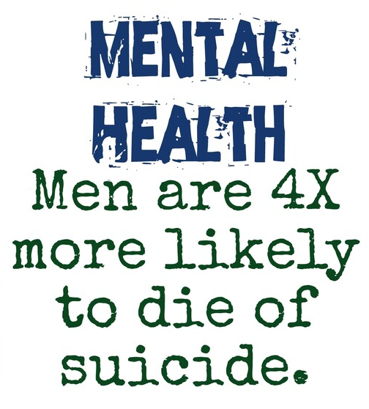



wellness corp.
Men’s mental health: Break the silence
Depression Stigma
Men often hesitate to express emotional suffering, delaying diagnosis. The lifetime prevalence is significant among men, reaching around 12% in some studies.
Suicide Risk
About 16 deaths per 100,000 men, compared to 7 deaths per 100,000 women.
Chemical Dependency
Men have a significantly higher rate of substance use disorders.
Mental health is often neglected in men. Recognizing symptoms and seeking help is vital.
Dr. Kevin Ramsamy – Urologist
www.wellness-corporate.com

Slide 15
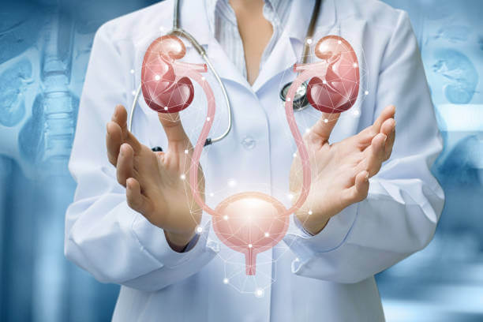
wellness corp.
The Urologist’s Role in Male Health
What is urology ?
A medical/surgical specialty that treats diseases of the urinary tract in both men and women, as well as the male reproductive health.
A urologist diagnoses, treats, and prevents conditions affecting these systems.
Main areas of the urologist's focus in men’s health:
Prostate health
Male sexual function
Urinary tract diseases
Pediatric urology (congenital malformations, undescended testicle)
Dr. Kevin Ramsamy – Urologist
www.wellness-corporate.com

Slide 16

wellness corp.
wellness corp.
Page 1
The urologist’s role for children
Detect malformations
Identify bedwetting (enuresis)
Diagnose infections
Handle urological emergencies
www.wellness-corporate.com
Dr. Kevin Ramsamy – Urologist
www.wellness-corporate.com

Slide 17

wellness corp.
Page 1
The Urologist’s Role in Adulthood
Kidney diseases
Bladder disorders
Prostate issues (rectal exam, PSA testing, etc.)
Testicular diseases
Erectile dysfunction
Fertility problems
Dr. Kevin Ramsamy – Urologist
www.wellness-corporate.com

Slide 18
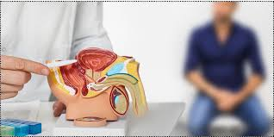
wellness corp.
Page 1
When To See a Urologist Urgently
Seek immediate care for:
Blood in urine
Intense pain (kidney stones, testicular pain, etc.)
Urinary retention
Never delay seeking medical help in these cases.
Dr. Kevin Ramsamy – Urologist
www.wellness-corporate.com

Slide 19
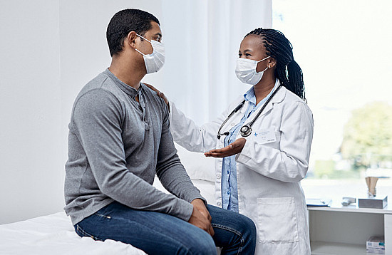
wellness corp.
Page 1
Understanding Medical Check-ups
What is a health check-up?
Why is it important?
When should it be done?
Dr. Kevin Ramsamy – Urologist
www.wellness-corporate.com

Slide 20
wellness corp.
Prevention and routine exams
Childhood | Self | Bedside | Laboratory
 | Parents aware to seek help for acute testicular pain | Growth : height, weight, growth charts. | Complete Blood Count Lipid profiles if overweight
 | Vaccinations | Disorders of sexual differentiation
 | Slow school progress may suggest eyesight issue or dietary issues | Confirm both testicles present in scrotum
 |  | General exams : Eye, sight, hearing, spine, gait, heart, oral health
From 20 - 40s | Regular/Monthly testicular exams | Blood Pressure | Yearly PSA for prostate cancer from 35 years
 |  | Fasting Blood Sugar | Blood Cholesterol : HDL and LDL
 |  | Urine Protein Assessment | Diabetes screening if risk factors present
 |  | BMI | One time Hepatitis C test
 |  |  | HIV testing and syphilis
40+ | Regular/Monthly Breast Exam | Blood Pressure | PSA for prostate cancer
 |  | Fasting Blood sugar every 3 years | Blood Chlosterol : HDL and LDL
 |  | Urine protein assessment | Liver and Kidney functions
 |  | Digital rectal exam | HbA1c test for diabetes every 3 years
 |  | BMI | Thyroid tests/Vitamin D levels

Slide 21
wellness corp.
Page 1
Prevention and routine exams
Other tests:
Colonoscopies from age 45 years every 5 years
Newer tests: fecal Occult blood and stool DNA tests
Dental 6 monthly.
Eye exam every 2 years.
One lifetime test for Hepatitis C.
Lung cancer screening:
Age 50 to 80 years old, and
20 pack year history, and
Currently smoke or quit within 15 years.
Osteoporosis screening only if risk factors present:
Long term steroid use
Low body weight
Smoking
Heavy alcohol use
Fracture after 50 years old
Skin Cancer screening:
Yearly check if:
Prior skin cancer
Family history
Immune compromise e.g., HIV positive
Sun exposure
Dr. Kevin Ramsamy – Urologist
www.wellness-corporate.com

Slide 22





wellness corp.
Practical Actions: Adopting Healthy Habits
Healthy Diet
5 portions of fruits and vegetables per day :
Prioritize natural foods (carrot, tomato,
spinach, mango, etc.), sources of lean protein.
Regular Physical activity
150 minutes per week, at least 30 minutes
per day, a combination of exercises..
Sleep Schedule
Aim for 7 to 9 hours of quality sleep per night.
Try to maintain a regular sleep schedule.
Exams and Regular Check-ups
Prevention and early detection are pillars of men's health.
Dr. Kevin Ramsamy – Urologist
www.wellness-corporate.com

Slide 23
wellness corp.
Summary: Take Action of Your Health
Cardiovascular
Eat healthy, exercise, avoid smoking
Male Cancers
Regular screenings and
self-exams.
Mental Health
Speak up and seek professional
General prevention
Healthy lifestyle and good sleep
Medical follow-up
Annual visits and routine tests
Men’s health is a personal investment. Every action counts toward a fulfilled life. Start taking care of yourself today.
Dr. Kevin Ramsamy – Urologist
www.wellness-corporate.com

Slide 24

wellness corp.
Page 1
Questions
If you have any doubts, please contact your physician or a urologist near you.
Dr. Kevin Ramsamy – Urologist
www.wellness-corporate.com

Slide 25

wellness corp.
Page 1
Thank you!
Kevin Ramsamy – Urologist
Website
www.wellness-corporate.com

